Slide 1


Creating technology innovations for low-resource communities
Llama English Chatterbot

Slide 2
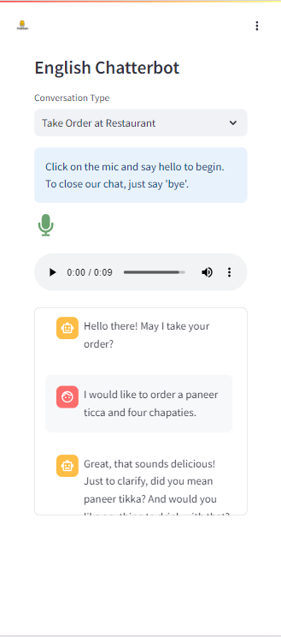
The Problem
Opportunities to practice English in low-resource communities are few and far in-between. With the help of the English Chatterbot, students can practice conversational English to build confidence, skills, and ability
The English Chatterbot, is an AI enabled practice tool, is built for youth (12-18) to practice casual conversational English
https://englishchatterbot.pradigi.org/
An online version has been piloted with 50 students in Pratham’s Vocational Programs
The major challenge to engagement during the pilot was the low internet connectivity in these communities
.

Slide 3
Proposed Solution
Given the low-resource nature of the communities we work with, having an offline model matters the most - Llama3.2 3B
For the Hackathon: Instruction-tuning the model so that it can run on laptop
Eventual Goal: To build a model that can run on mobile

Slide 4
The Unique Proposition
Offline
An offline model will enable access in low-resource communities without the worry of internet connectivity. This will promote regular usage and practice leading to better learning outcomes
Privacy first
Children’s data is extremely sensitive and needs to be dealt with carefully. An offline model will also ensure privacy
Tailored to Indian Context
Tuning the model will help adapt to the Indian context with relevant examples that can keep the students engaged

Slide 5



Tech Stack
Step 1: Generating Synthetic Conversations using Llama3.1 405B using pilot data as the standard
Step 2: Data Augmentation by splitting the conversation into chunks of multiple lengths
Step 3: Instruction Tuning Llama 3.2 3B Model and pushing it to HuggingFace Hub. The 5-bit quantized version works best, hosted here
https://huggingface.co/Sravana/llama_chatterbot_2
Step 4: Integrating FastAPI and Ollama to access the model from device
Step 5: Integrating Deepgram ASR and Azure TTS into the FastAPI app for enabling voice capability

Slide 6
Larger Vision
Chatterbot
Mobile
Improve Data Quality
VAD for hands free usage
Offline ASR/TTS Models
Everyday Scenarios
The English Program
One of our major areas of focus this year is a comprehensive English program
SImilar to all Pratham programs, social infrastructure will be a fundamental building block
AI Enabled Tech Elements to be developed to complement the program
Conversational piece of the program
Some of the other features include reading practice and assessment, reading comprehension tests etc.,

